Slide 1
Model-Based Decomposition
ESTP training

Slide 2
0. Outline
Unobserved component models
STS, AMB
SEATS algorithm
Estimation
MMSE estimators, algorithms
Analysis
Finite / infinite approaches
SEATS in JD+
Parameters, non decomposable models, estimation

Slide 3
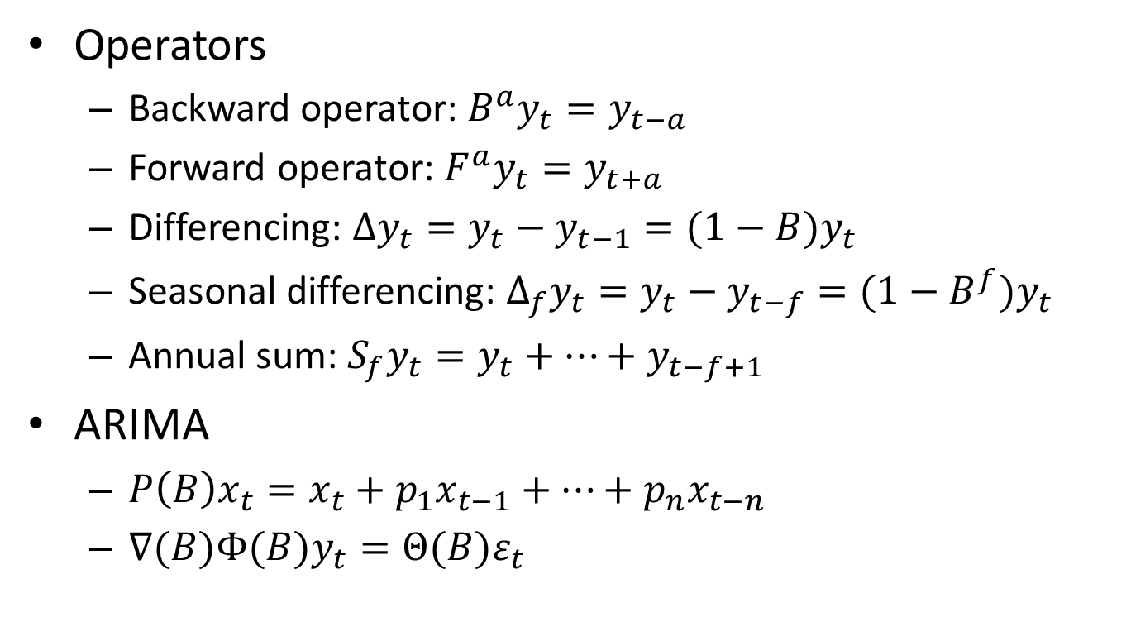
0.1 Some notations
Operators
Backward operator: $B^{a}y_{t}=y_{t−a}$
Forward operator: $F^{a}y_{t}=y_{t+a}$
Differencing: $∆y_{t}=y_{t}−y_{t−1}=(1−B)y_{t}$
Seasonal differencing: $∆_{f}y_{t}=y_{t}−y_{t−f}=(1−B^{f})y_{t}$
Annual sum: $S_{f}y_{t}=y_{t}+⋯+y_{t−f+1}$
ARIMA
$P\left(B\right)x_{t}=x_{t}+p_{1}x_{t−1}+⋯+p_{n}x_{t−n}$
$∇(B)Φ(B)y_{t}=Θ(B)ε_{t}$

Slide 4
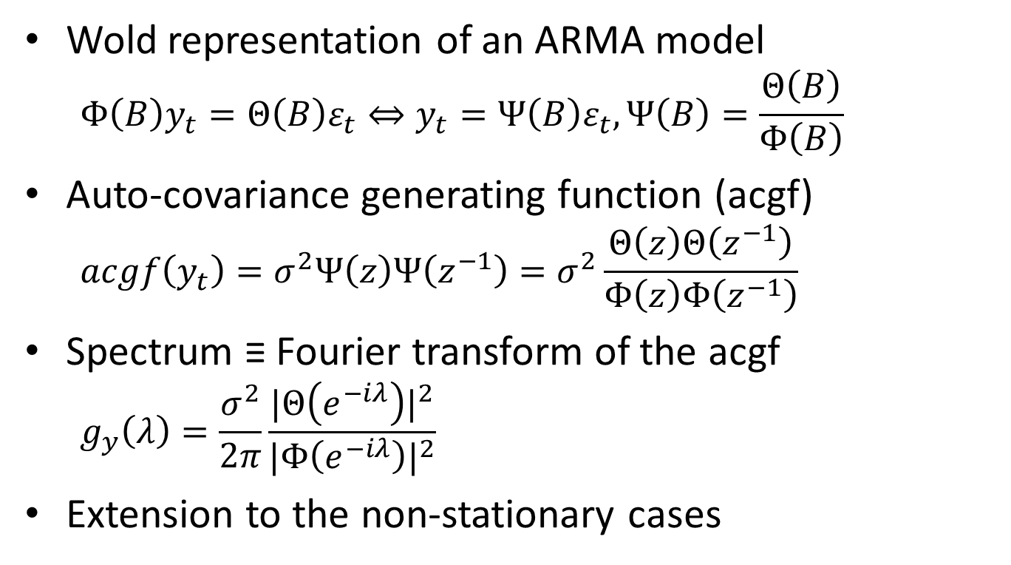
0.2 Useful tools
Wold representation of an ARMA model
$$Φ\left(B\right)y_{t}=Θ\left(B\right)ε_{t}⇔y_{t}=Ψ\left(B\right)ε_{t},Ψ\left(B\right)=\frac{Θ\left(B\right)}{Φ\left(B\right)}$$
Auto-covariance generating function (acgf)
$$acgf\left(y_{t}\right)=σ^{2}Ψ\left(z\right)Ψ\left(z^{−1}\right)=σ^{2}\frac{Θ\left(z\right)Θ\left(z^{−1}\right)}{Φ\left(z\right)Φ\left(z^{−1}\right)}$$
Spectrum ≡ Fourier transform of the acgf
$$g_{y}\left(λ\right)=\frac{σ^{2}}{2π}\frac{{|Θ\left(e^{−iλ}\right)|}^{2}}{{|Φ\left(e^{−iλ}\right)|}^{2}}$$
Extension to the non-stationary cases

Slide 5
1. Unobserved components model
Principle
The different components of the series are “defined” by [ARIMA] models
The components are independent
The sum of the model of the components is the model of the series

Slide 6





1.1 Unobserved components model (STS)
Theoretical model
Series($θ_{T,S,I})$
Trend($θ_{T})$
Seasonal($θ_{S})$
Irregular($θ_{I})$
<=
+
+
Independent
$${\hat{θ}}_{T,S,I}$$
Observed time series

Slide 7
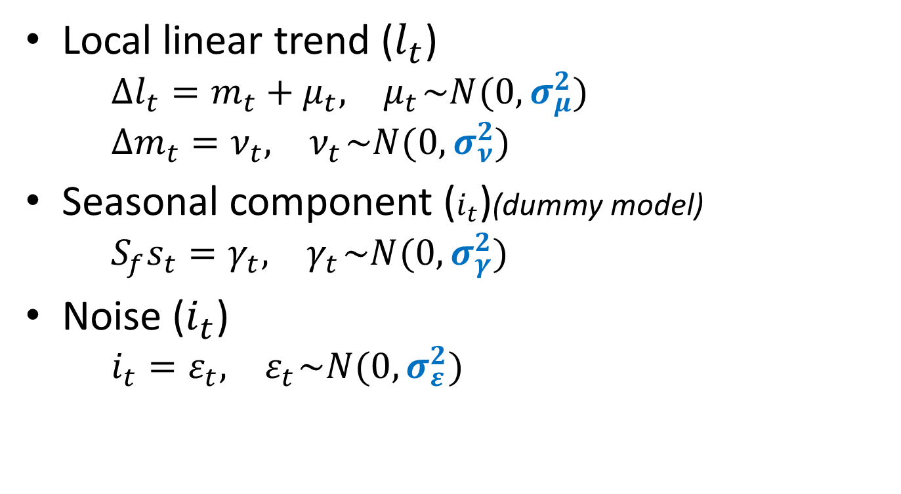
1.1.1 Basic structural model (STS)
Local linear trend ($l_{t}$)
$$∆l_{t}=m_{t}+μ_{t},{ μ}_{t}\sim N(0, σ_{μ}^{2})$$
$$∆m_{t}=ν_{t},{ ν}_{t}\sim N(0, σ_{ν}^{2})$$
Seasonal component ($i_{t}$)(dummy model)
$$S_{f}s_{t}=γ_{t},{ γ}_{t}\sim N(0, σ_{γ}^{2})$$
Noise ($i_{t}$)
$$i_{t}=ε_{t},{ ε}_{t}\sim N(0, σ_{ε}^{2})$$

Slide 8





1.2 Unobserved components model (AMB)
Theoretical model
Series($θ_{Y})$
Trend($θ_{Y})$
Seasonal($θ_{Y})$
Irregular($θ_{Y})$
=>
+
+
Independent
$${\hat{θ}}_{Y}$$
Observed time series

Slide 9

1.2.1 Airline model
$ΔΔ_{f}y_{t}=Θ(B)$ $Θ\left(B^{f}\right)$ $ε_{t},{ ε}_{t}\sim N\left(0, σ_{ε}^{2}\right)$
Or
$$y_{t}={y_{t−f}+(y}_{t−1}−y_{t−f−1})+$$
$$ε_{t}+θ_{f}ε_{t−f}+θ(ε_{t−1}+θ_{f}ε_{t−f−1}),$$
$${ ε}_{t}\sim N\left(0, σ_{ε}^{2}\right)$$

Slide 10
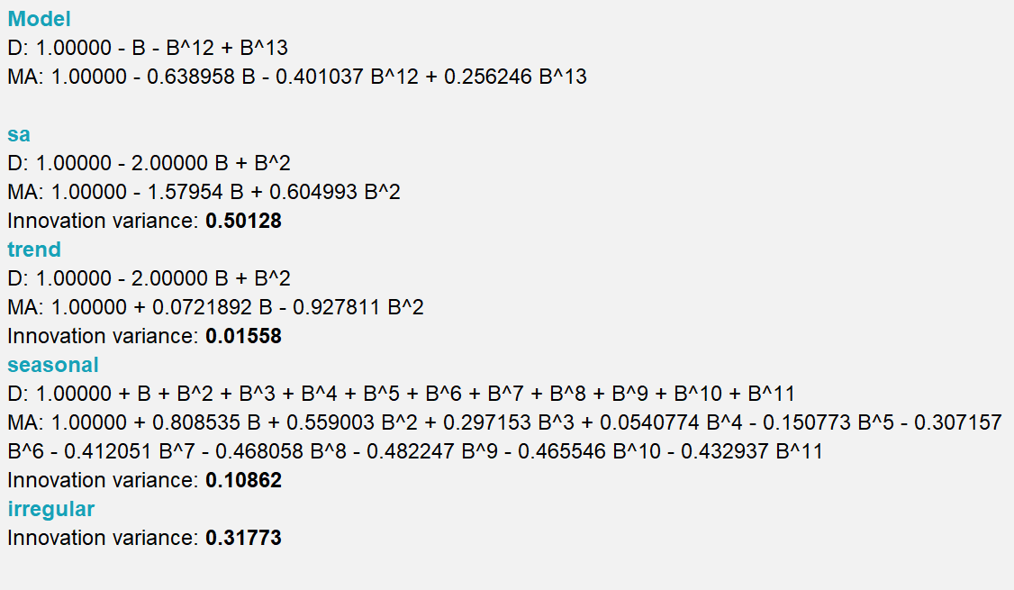
1.2.2 Airline decomposition

Slide 11
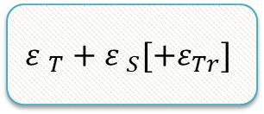

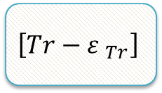



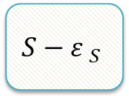
2. SEATS algorithm
Factorization based on the auto-regressive part (AR and I)
ARIMA
$$T$$
$$S$$
$\left[Tr\right]$
See:
Gomez and Maravall…
Canonical decomposition
$$T−{ε }_{T}$$
$$S−{ε }_{S}$$
$$\left[Tr−{ε }_{Tr}\right]$$
$${ε }_{T}+{ε }_{S}[+ε_{Tr}]$$

Slide 12
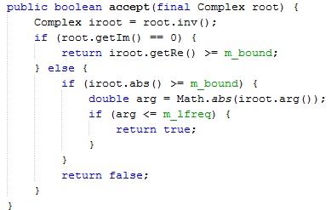
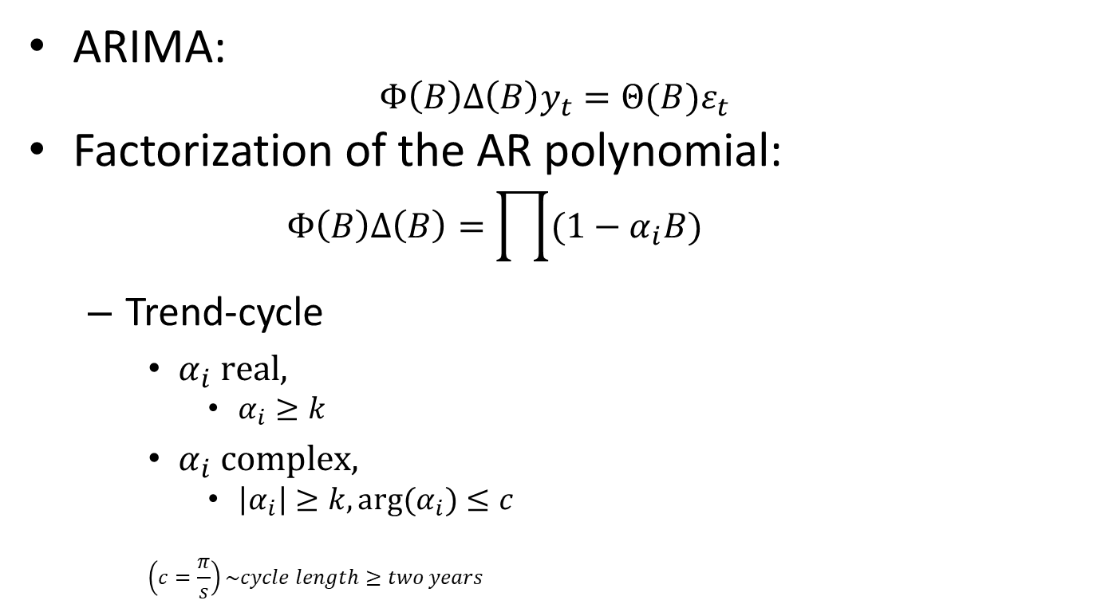
2.1 SEATS Algorithm. Details (I)
ARIMA:
$$Φ\left(B\right)Δ\left(B\right)y_{t}=Θ(B)ε_{t}$$
Factorization of the AR polynomial:
$$Φ\left(B\right)Δ\left(B\right)=\prod{(1−α_{i}B)}$$
Trend-cycle
$α_{i} real,$
$α_{i}≥k$
$α_{i} complex,$
$\left|α_{i}\right|≥k, arg(α_{i})≤c$
$$\left(c=\frac{π}{s}\right)\sim cycle length≥two years$$
TrendCycleSelector.java

Slide 13
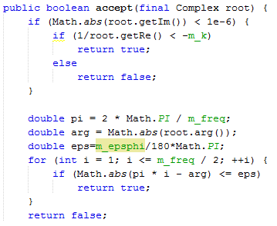

Seasonal
$α_{i} real,$
$α_{i}<−l$
$α_{i} complex,$
$\left|arg\left(α_{i}\right)−f_{s}\right|≤e$
$$f_{s} seasonal frequency$$
Transitory (I)
All other roots
SeasonalSelector.java
Trend boundary | k
Seasonal tolerance (degree) | e
Seasonal boundary | l
Seas.boundary (unique) | l (no seasonal part)

Slide 14
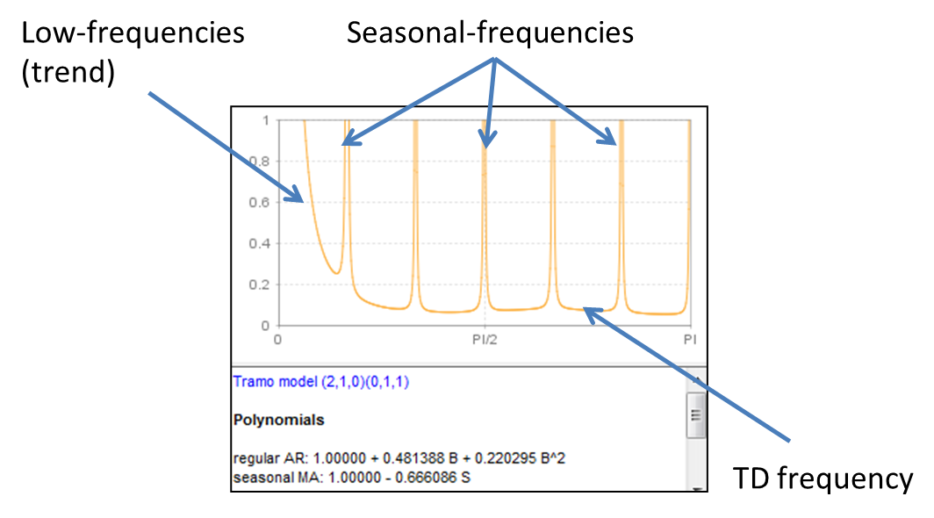
2.2 SEATS spectral decomposition
Splitting of the spectrum following the different « types » of frequencies

Slide 15
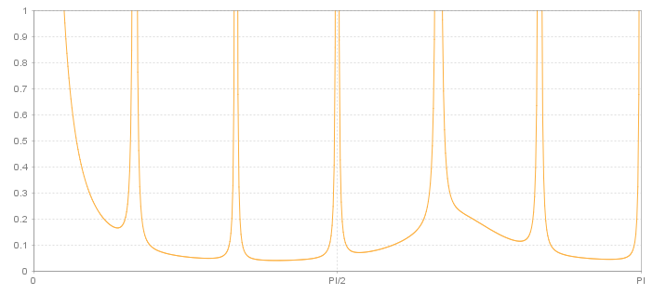
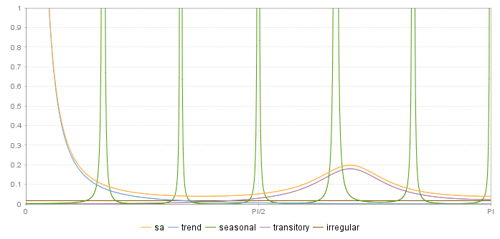


2.2 SEATS spectral decomposition
$$S_{Y}=S_{T}+S_{S}+S_{Tr}+S_{I}$$
$$S_{SA}=S_{T}+S_{Tr}+S_{I}=S_{Y}−S_{S}$$
Independent components !

Slide 16
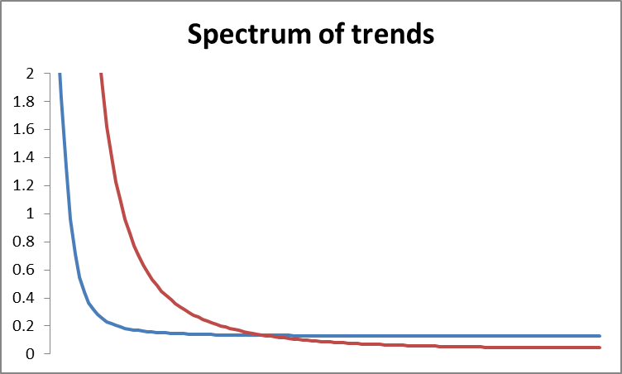
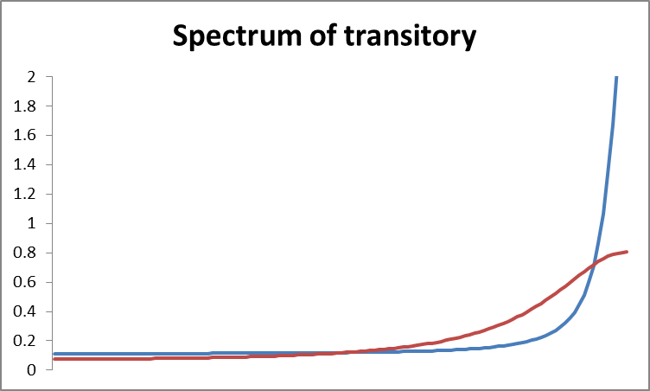
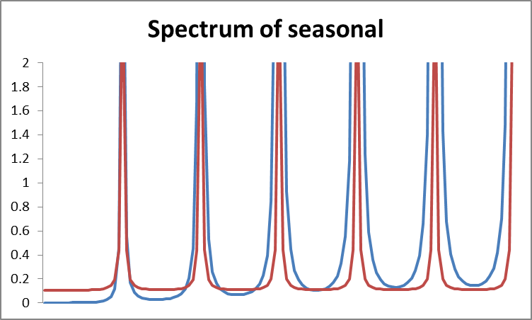
2.2 SEATS spectral decomposition
Smoother trend
Switchback pattern
More stable seasonal

Slide 17
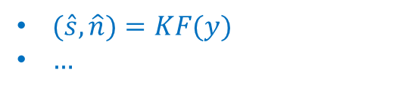
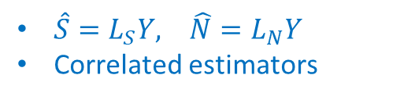
3. Estimation of the model
Independant components
Sum of cmps <=> y
Components model
Estimators = Linear transformations of y
MMSE criterion
Components estimators
$\hat{S}=L_{S}Y, \hat{N}=L_{N}Y$
Correlated estimators
Estimation by means of KF, Burman’s, McElroy’s algorithms…
Components estimates
$(\hat{s},\hat{n})=KF(y)$
$…$

Slide 18
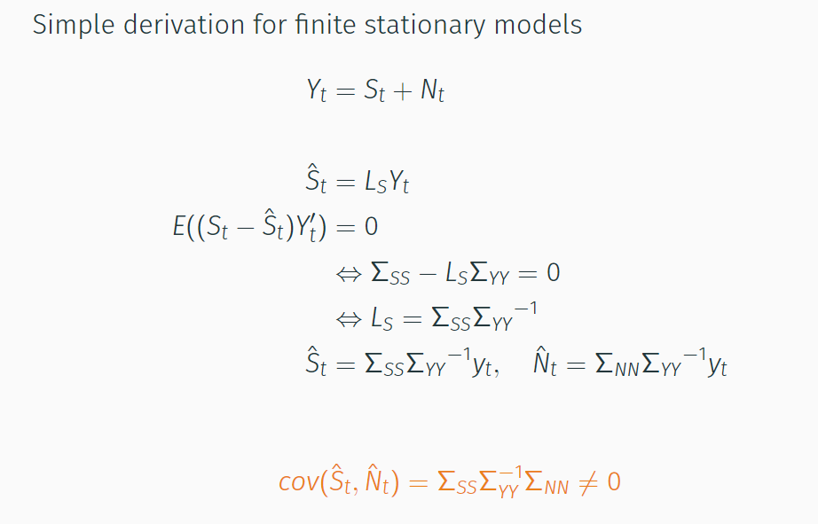
3.1 Basic case

Slide 19
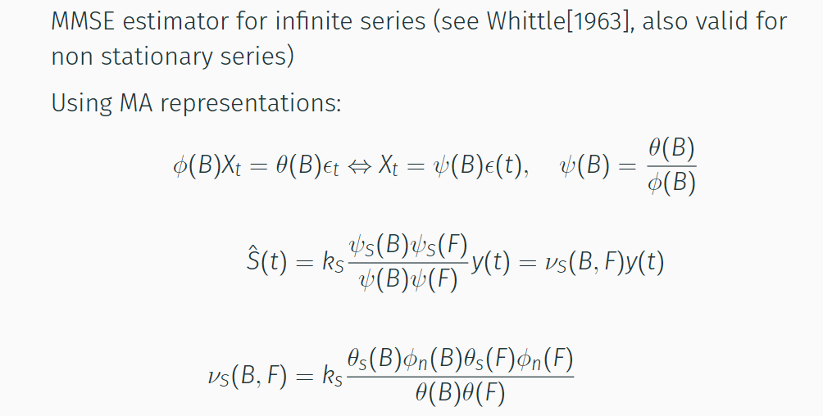
3.2 Wiener-Kolmogorov filters

Slide 20
3.3 Estimation of the components
STS and AMB → UCARIMA models
Same estimation algorithms
Common analysis tools
3 solutions, strictly equivalent (except for SD)
Burman algorithm (WK filters): legacy and default solution, fastest
Kalman smoother: more stable, exact SD
[Matrix computation]: Not available in JD+ 3.x

Slide 21
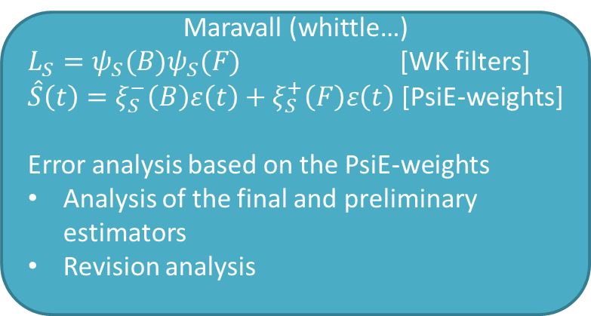
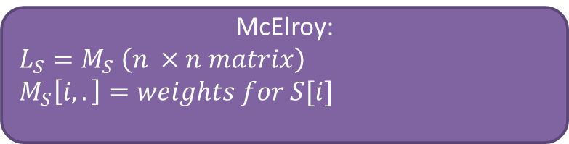
4. Analysis
McElroy:
$$L_{S}=M_{S} \left(n ×n matrix\right)$$
$$M_{S}\left[i,.\right]=weights for S[i]$$
Components estimators
Maravall (whittle…)
$L_{S}=ψ_{S}(B)ψ_{S}(F)$ [WK filters]
$\hat{S}\left(t\right)=ξ_{S}^{−}\left(B\right)ε\left(t\right)+ξ_{S}^{+}\left(F\right)ε\left(t\right)$ [PsiE-weights]
Error analysis based on the PsiE-weights
Analysis of the final and preliminary estimators
Revision analysis

Slide 22
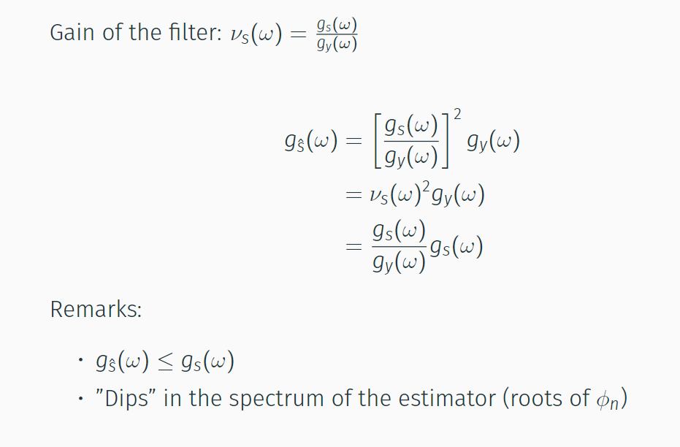
4.1 Analysis in the frequency domain

Slide 23
4.1 Analysis in the frequency domain
(Squared-) gain of the filters:
What are the frequencies that are kept/removed by the filter
The estimators “underestimate” the variance of the components
Similar analysis for the preliminary estimators
Non-symmetric filters → phase effects

Slide 24
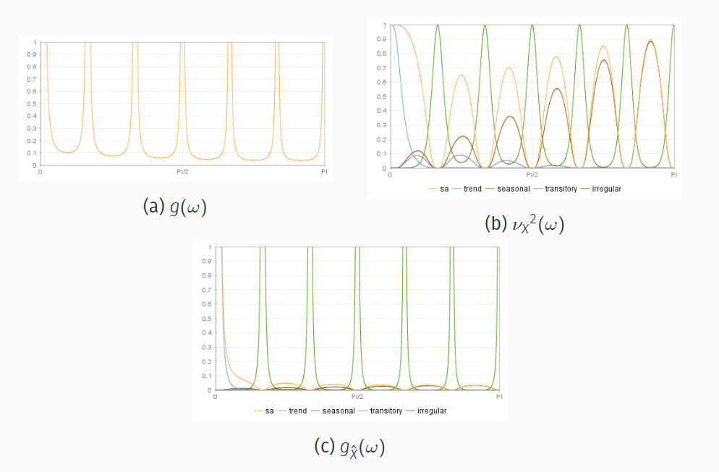
4.2 Graphical representations

Slide 25
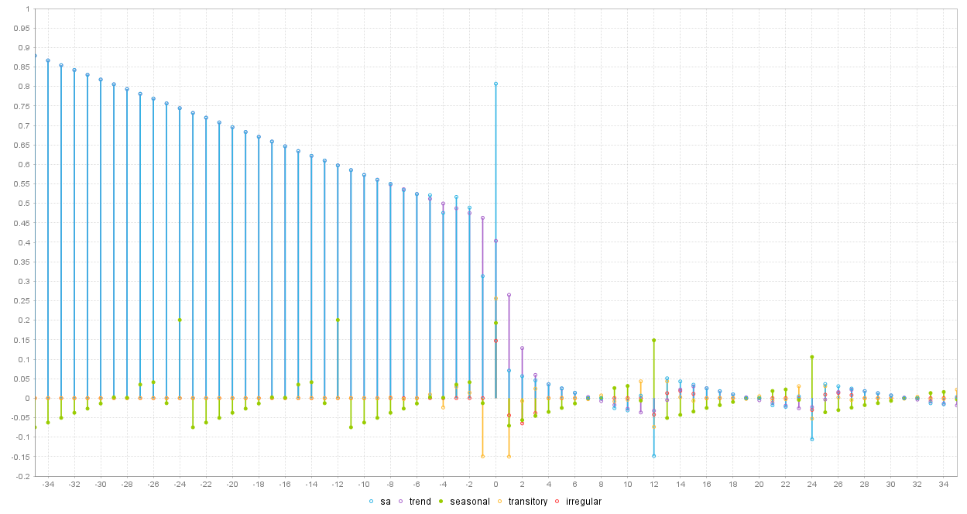
4.2 PsiE-weights
=Psi weights for estimators

Slide 26
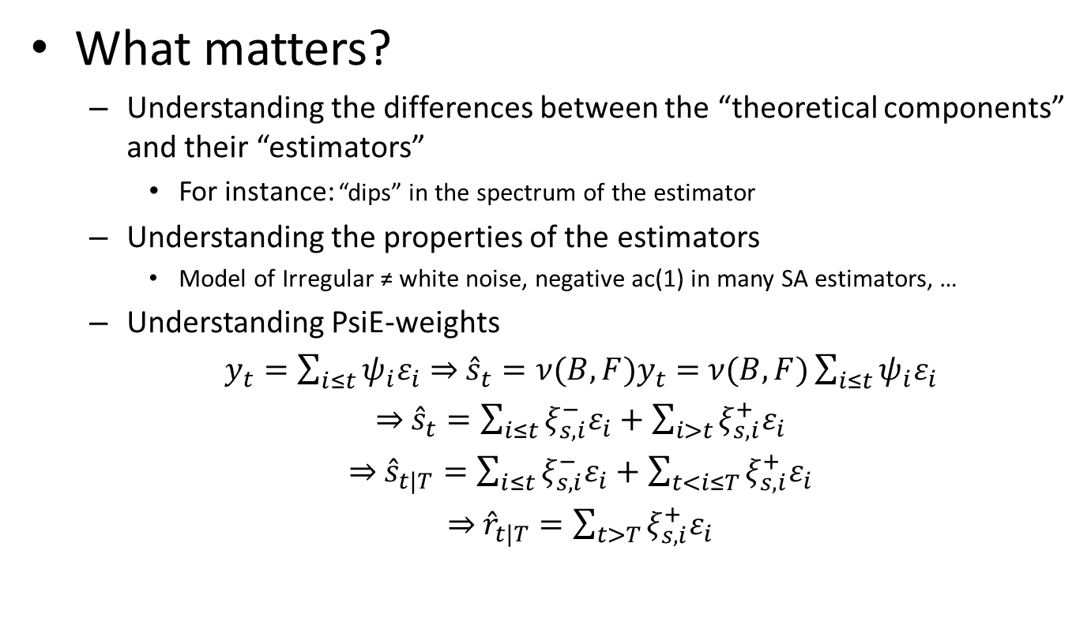
4.3 Analysis
What matters?
Understanding the differences between the “theoretical components” and their “estimators”
For instance: “dips” in the spectrum of the estimator
Understanding the properties of the estimators
Model of Irregular ≠ white noise, negative ac(1) in many SA estimators, …
Understanding PsiE-weights
$y_{t}=\sum_{i≤t}{ψ_{i}ε_{i}}⇒$ ${\hat{s}}_{t}=ν(B,F)y_{t}=$ $ν(B,F)\sum_{i≤t}{ψ_{i}ε_{i}}$
$⇒$ ${\hat{s}}_{t}=\sum_{i≤t}{ξ_{s,i}^{−}ε_{i}}+\sum_{i>t}{ξ_{s,i}^{+}ε_{i}}$
$⇒$ ${\hat{s}}_{t|T}=\sum_{i≤t}{ξ_{s,i}^{−}ε_{i}}+\sum_{t<i≤T}{ξ_{s,i}^{+}ε_{i}}$
$⇒$ ${\hat{r}}_{t|T}=\sum_{t>T}{ξ_{s,i}^{+}ε_{i}}$

Slide 27
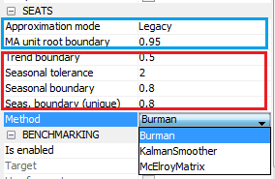
5. SEATS in JD+
Modification of the model
Decomposition of the model
Estimation of the components

Slide 28
5.1 SEATS in JD+ (cont.)
Impact of the parameters
Only in case of AR polynomials
k
Small: possible « noisy » trend
k ≈ 1: more stable trend
e
Large (>5): possible short term cycle in the seasonal (for instance, stochastic TD)→erratic seasonal
l
Small (<.8): higher risk of erratic seasonal
General consideration: threshold effects are unavoidable

Slide 29
5.2 Non decomposable models
Some models are not decomposable (often due to complex models)
Best solution: change yourself the model (→airline)
Otherwise:
Legacy: Seats search for another SARIMA model, as similar as possible to the original model
Noisy: Seats add noise in the initial model (→ I = Tr[= 0])

Slide 30
6. Final remarks
What matters?
Impact of the model on
SA/S “smoothness” ⇒ Be very careful with stationary AR roots
Revisions
Use PsiE-weights to understand/anticipate revisions
Model-based diagnostics
Variance estimators<> variance estimates
Should not happen if the original model is well defined
Be careful with non decomposable models / fixed models / “bad” models
To go further, see:
“SEASONAL ADJUSTMENT AND SIGNAL EXTRACTION IN ECONOMIC TIME SERIES”, by R. Gomez and A. Maravall

